Slide 1
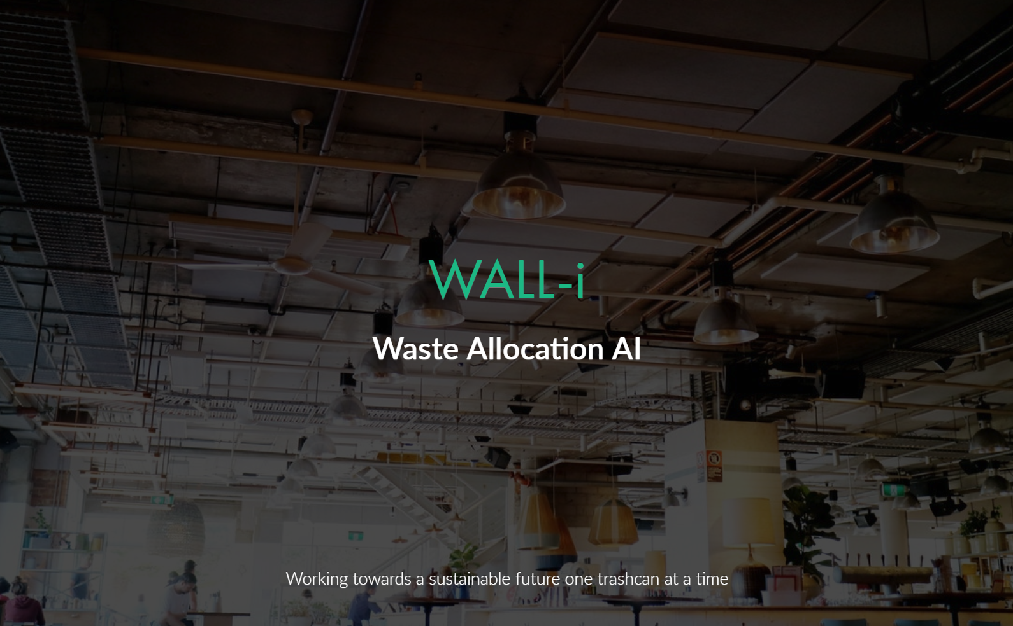

Slide 2
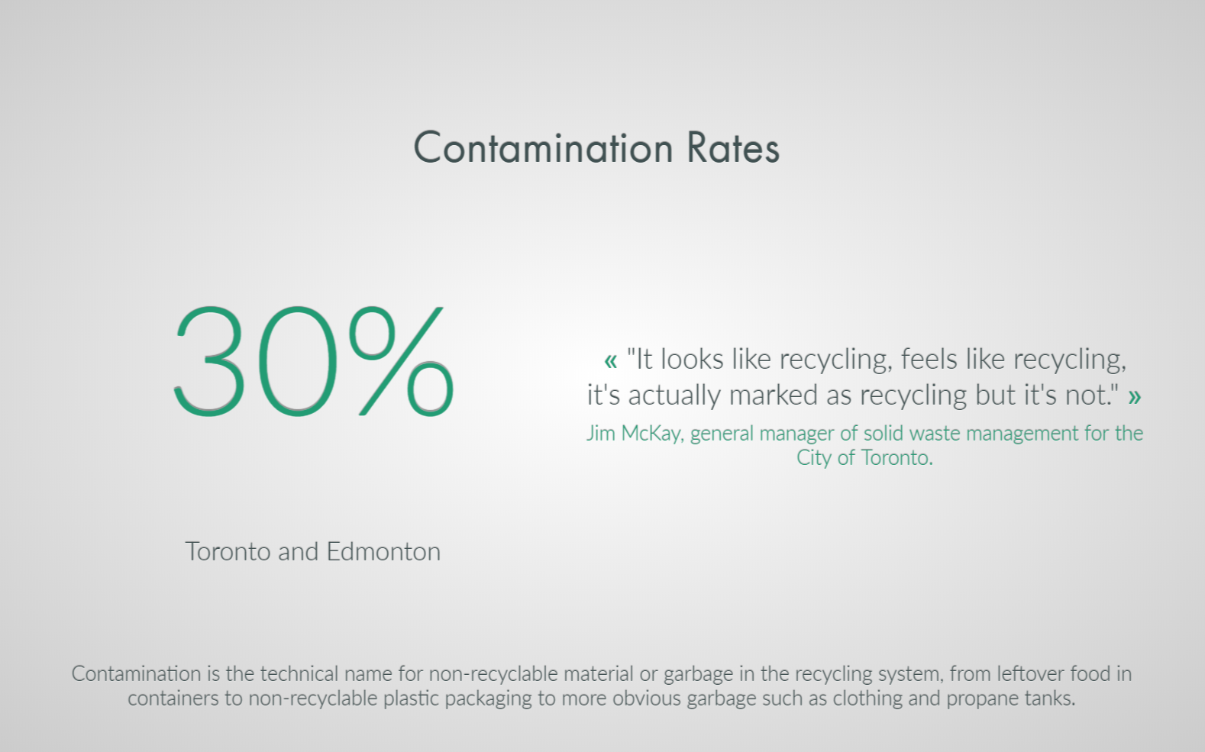

Slide 3
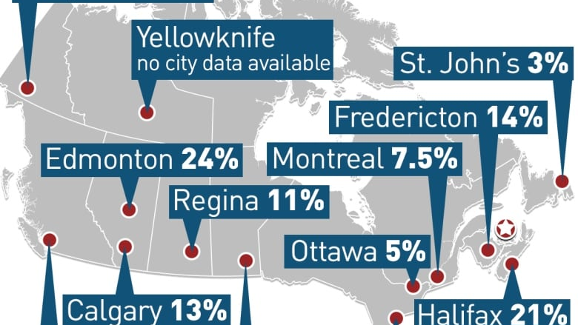

Slide 4
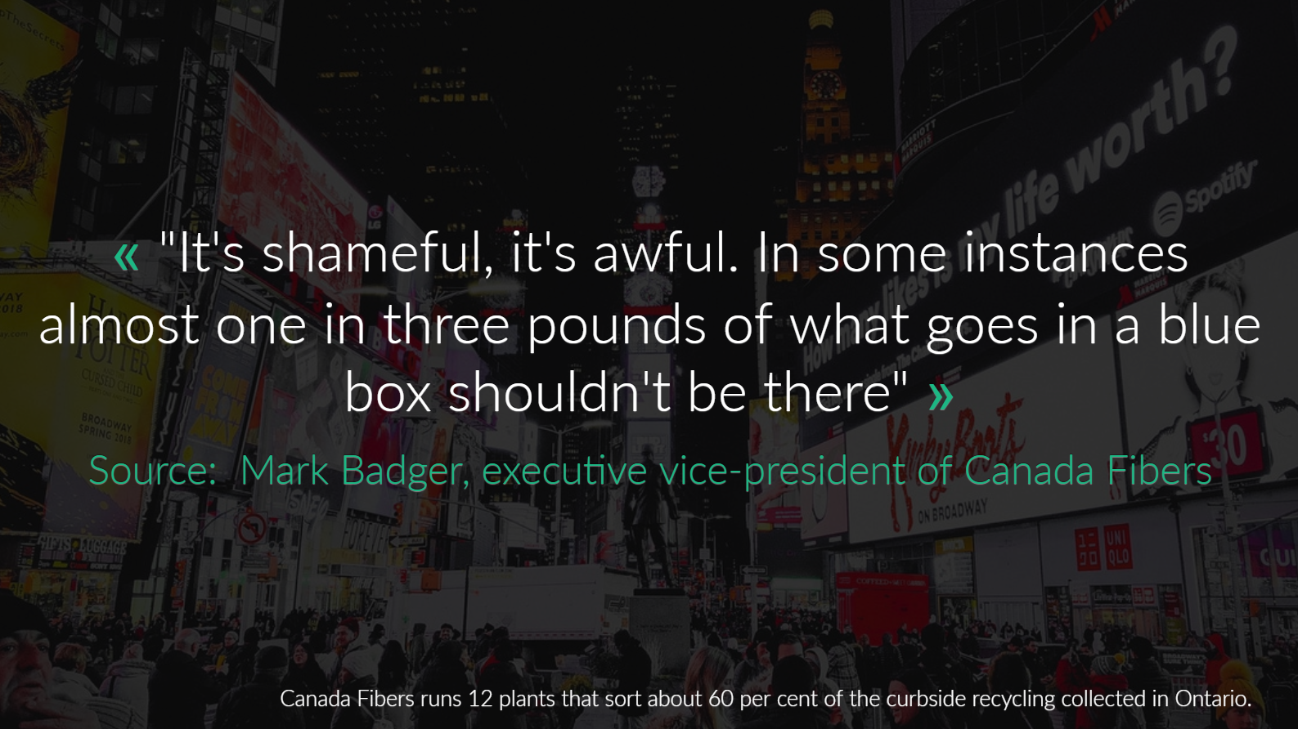

Slide 5
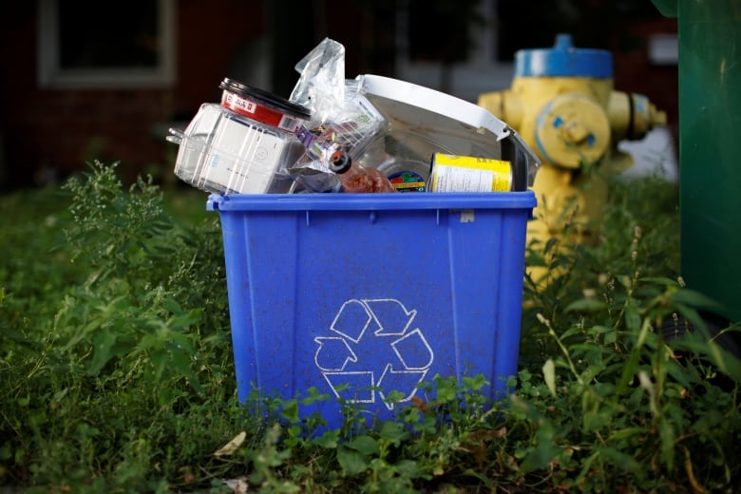
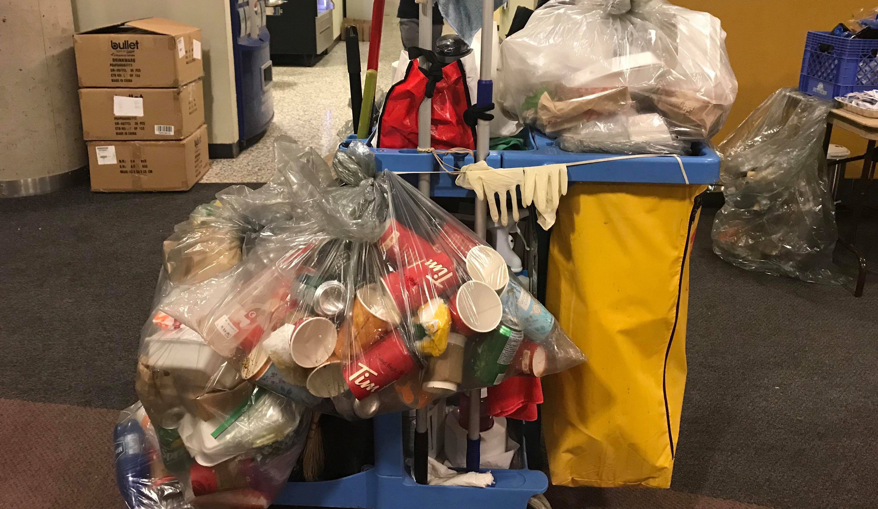
INCORRECT WASTE DISPOSAL
How much is it costing corporations to rectify that simple mistake?
SHORT ANSWER? QUITE A LOT!
Notes:
if the city's average contamination rate reaches 27 per cent, it will get hit with an extra $5 million charge

Slide 6
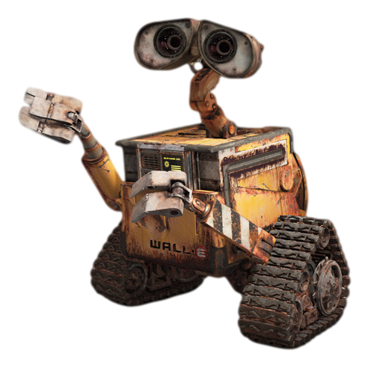
WALL-i SMART DUSTBIN
We plan to reduce costs drastically with this smart solution, allowing waste collection agencies to save like never before, and ensure a better and more sustainable future for all!

Slide 7
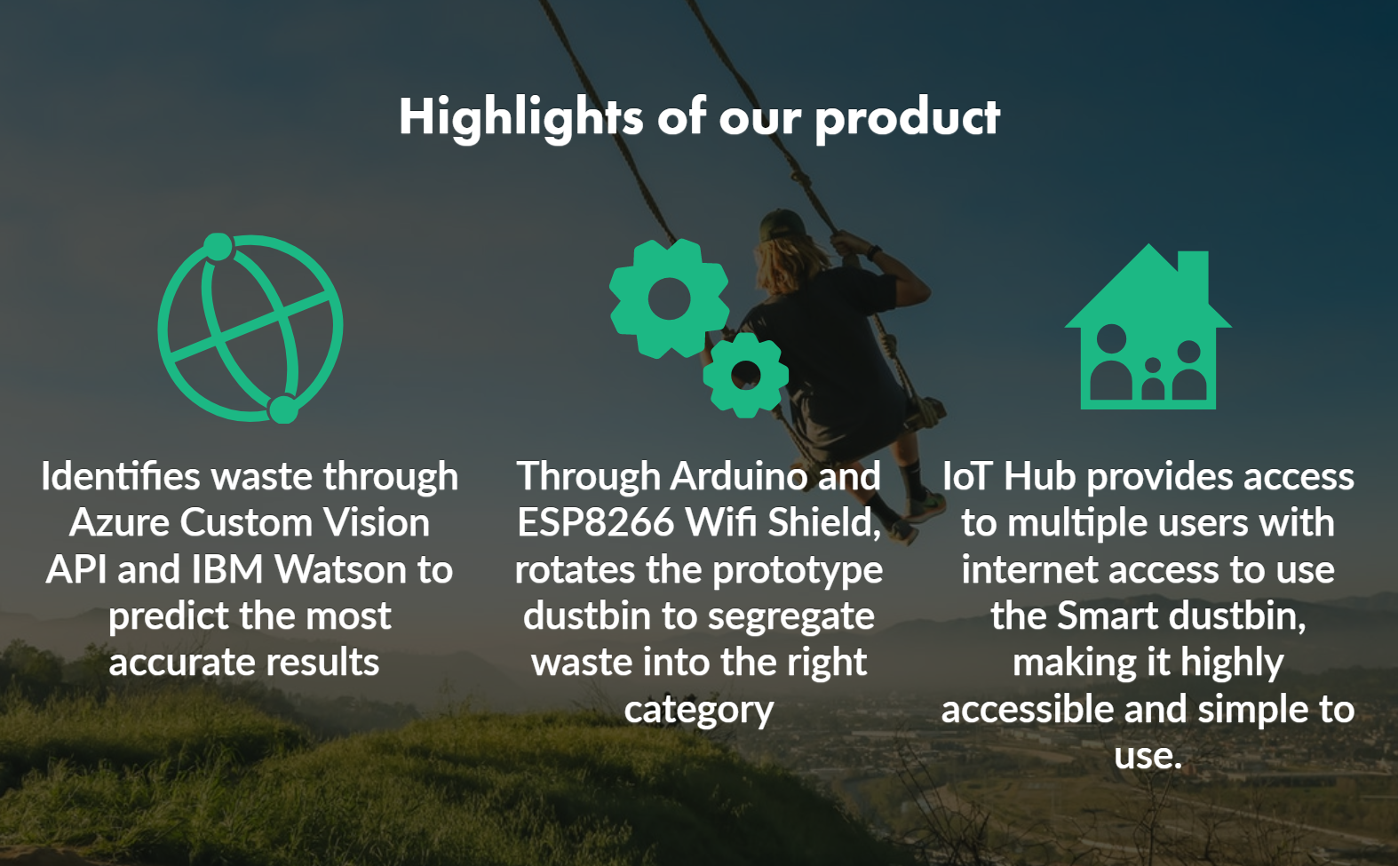

Slide 8
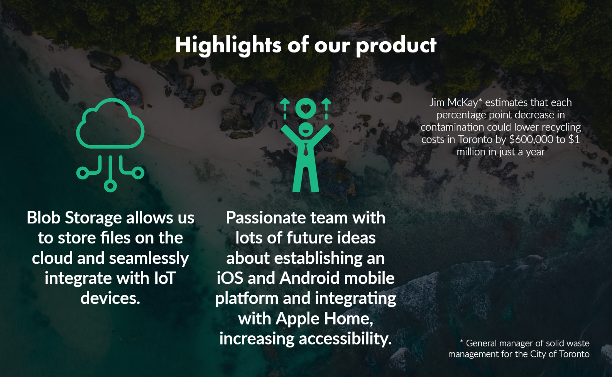

Slide 9

FIRST
DESIGN

Slide 10




SWOT Analysis
S
STRENGTHS
WEAKNESSES
W
Unique use case
Addresses a current pain point
Requires access to a source of power (electricity/battery)
O
OPPORTUNITIES
THREATS
T
Rising problem for sustainable living and cities
Big waste corporations seeking unique solutions

Slide 11
MARKETING TIMELINE
Sell to Households, Individuals and Small Businesses.
Waste Management Corporations
Partner with Ontario Waste Management Association
June 2019
2020
Dec 2019
2021
Develop the product for initial launch
Develop a more customer facing interface through an app
Sell to other businesses looking to improve their social responsibility and cut waste collection costs

